Slide 1
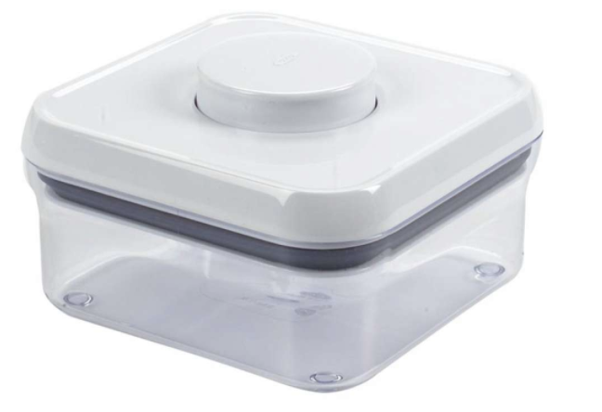
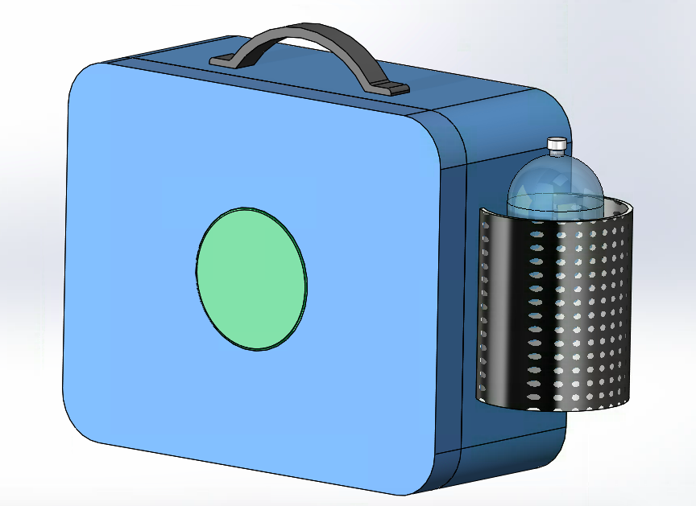
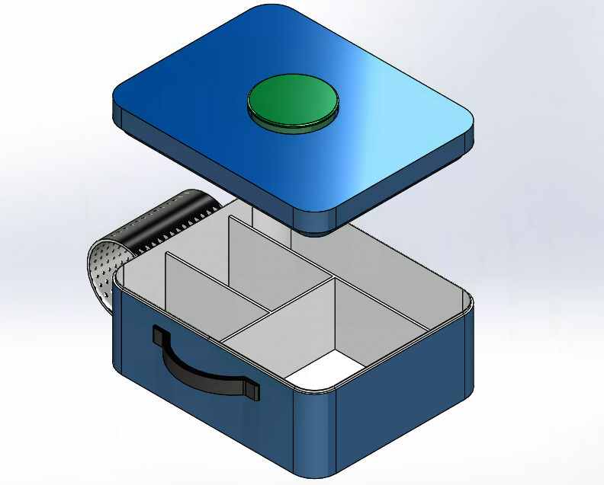
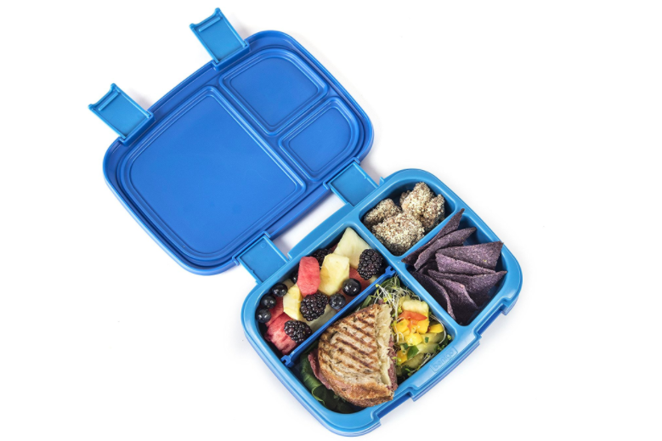
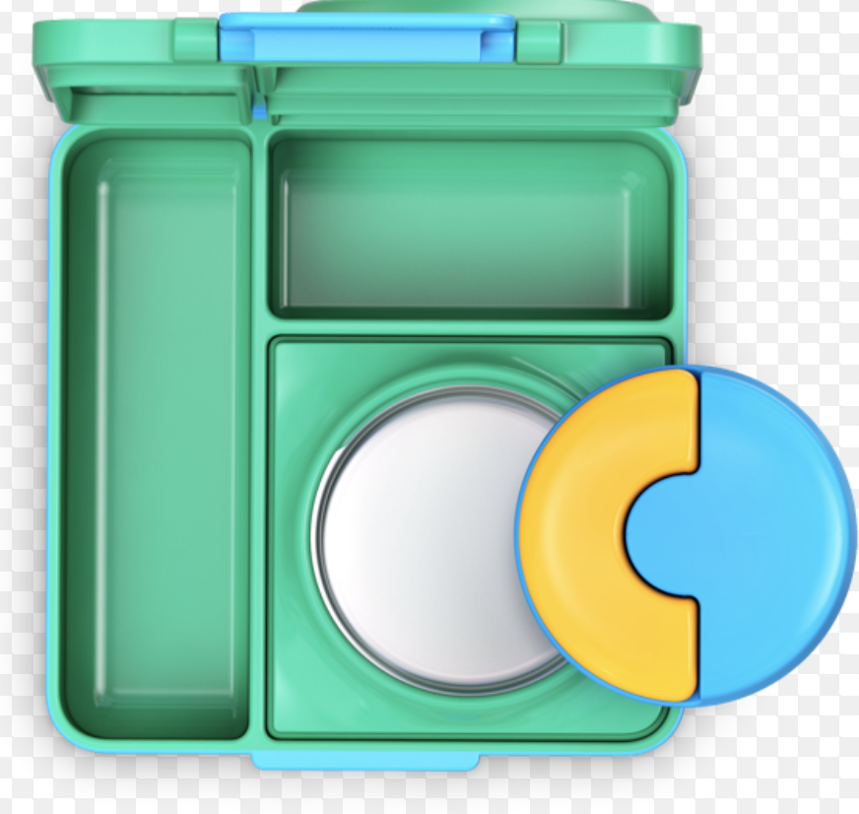
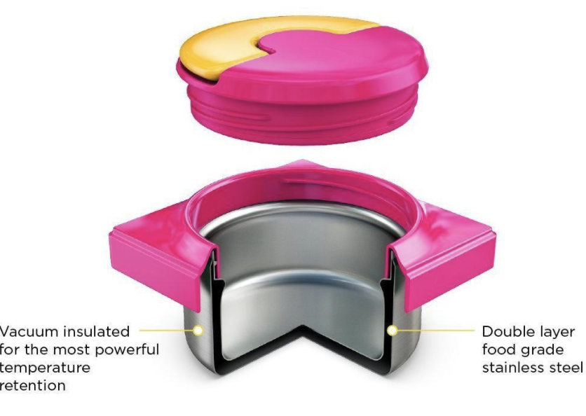
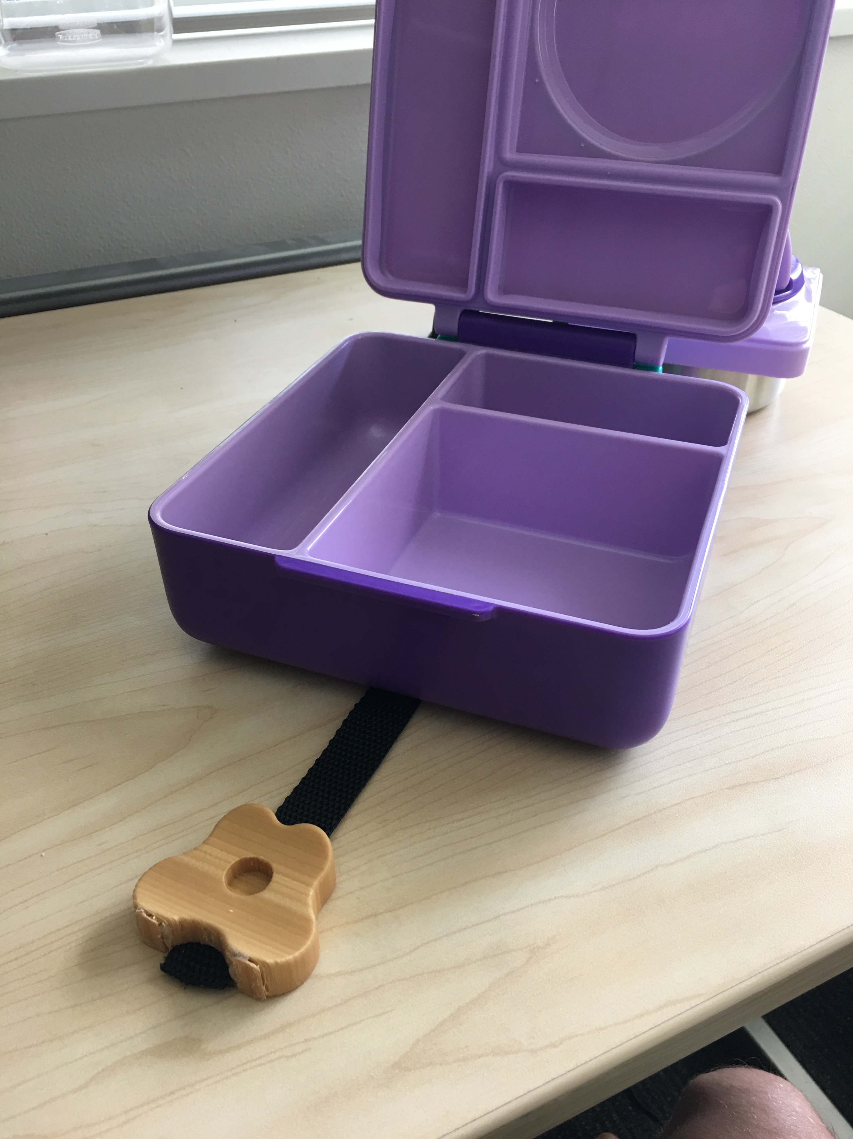
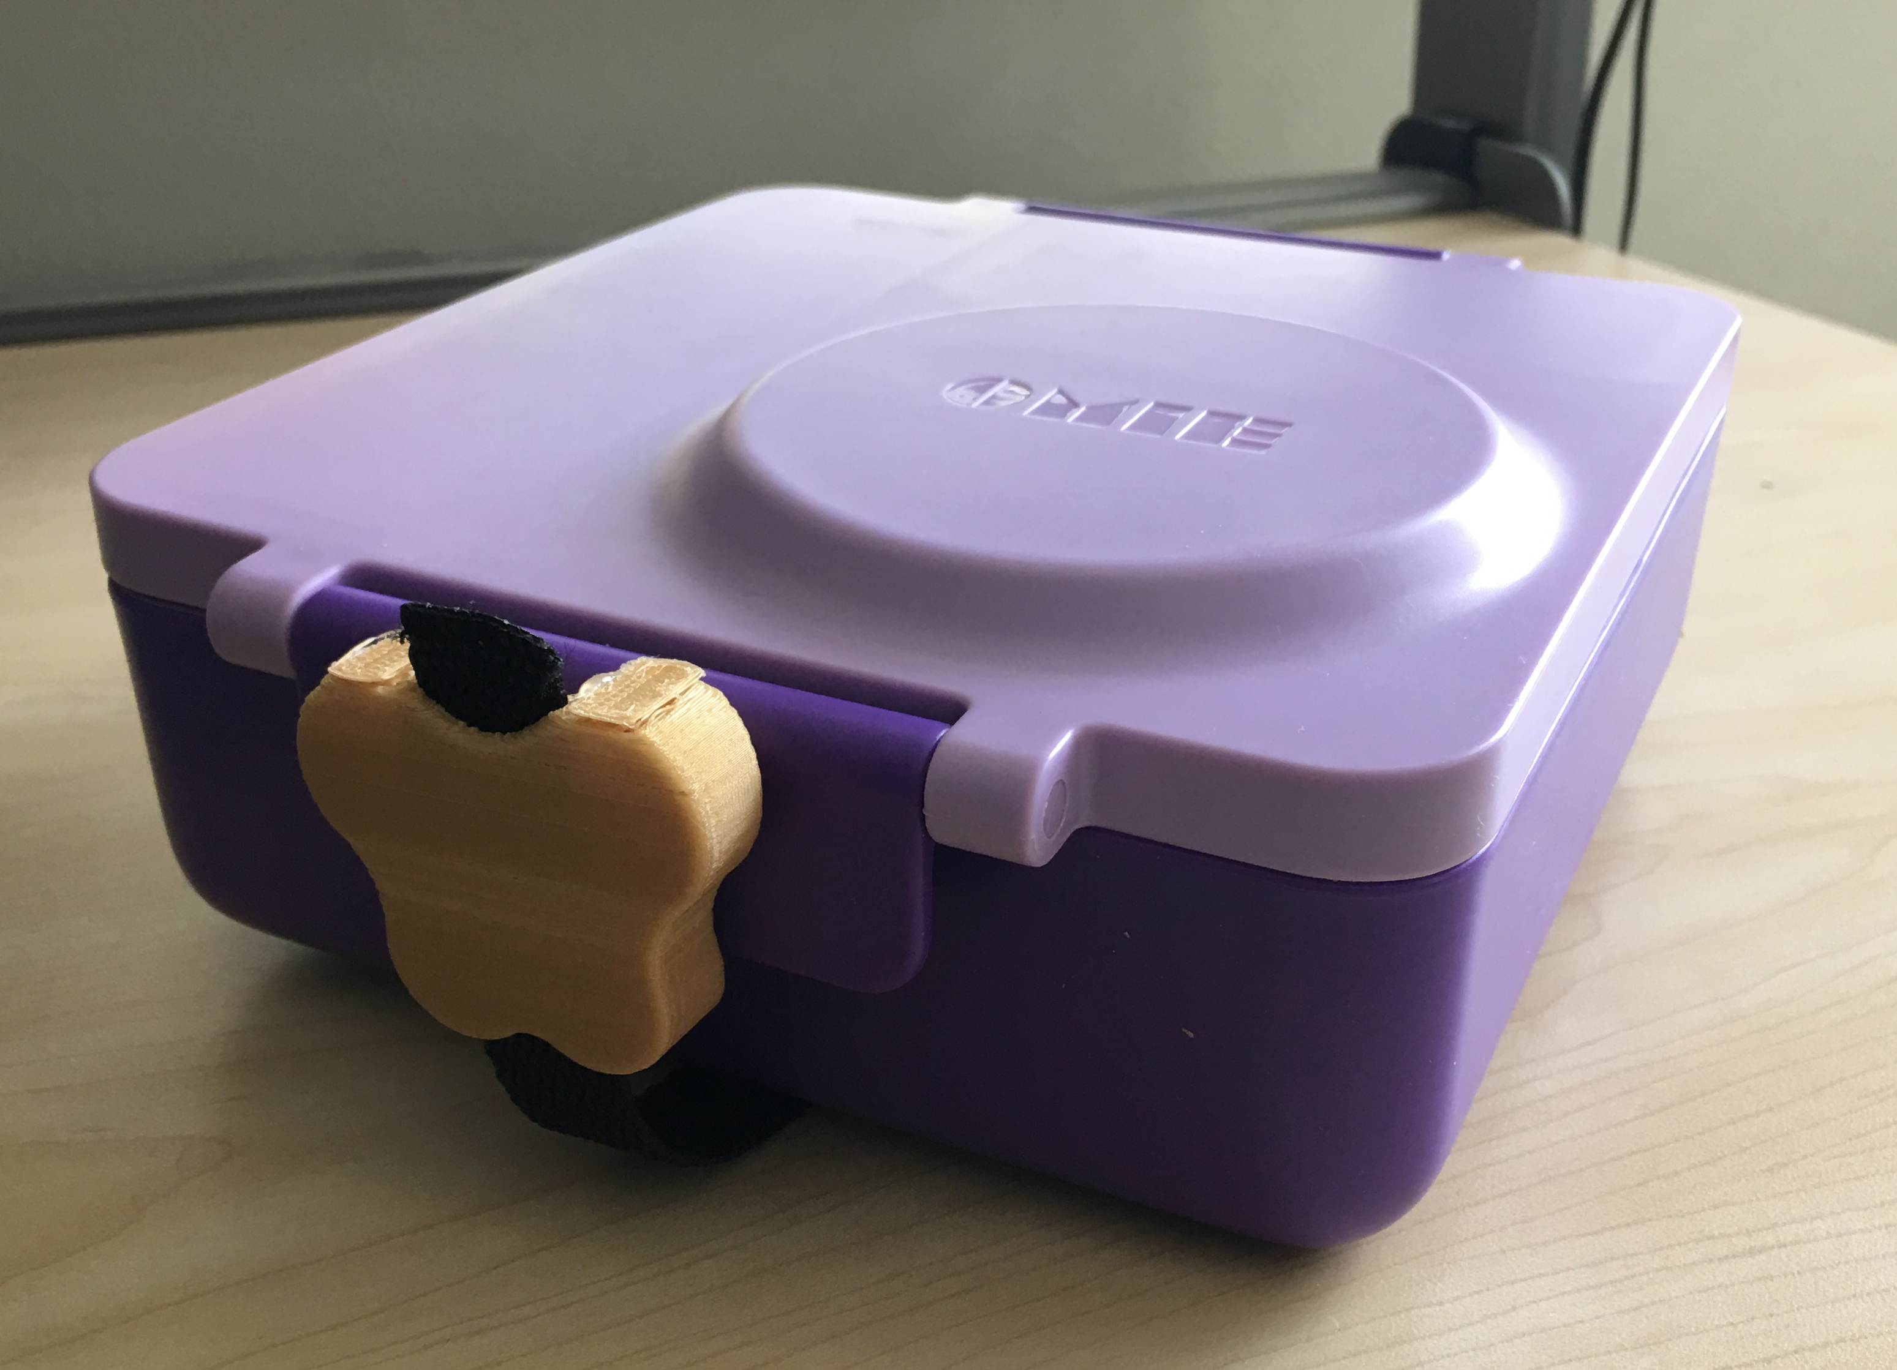
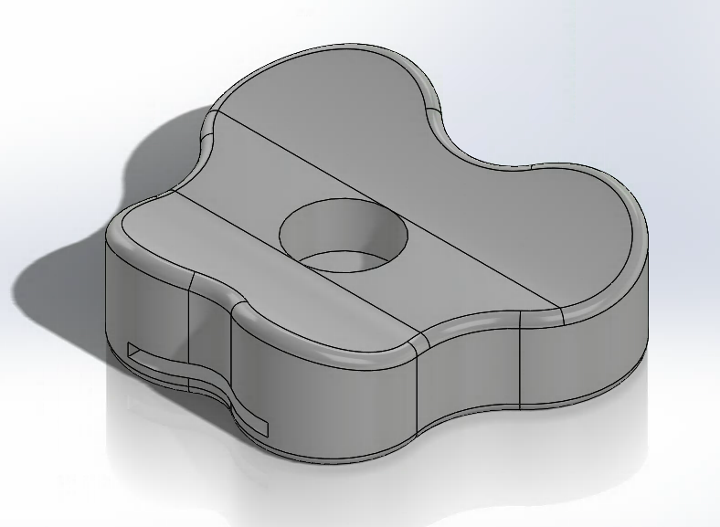
The Butterfly
¹Marzi Branyan, ²Nikita Kovalovs, & ³Jayna Doll
¹Intended Neurobiology, ²Human Centered Design and Engineering,
³Needs Expert
Abstract
Opening a lunchbox is a two-handed task; one hand is used to stabilize the box while the other is used to unlatch and take off the lid. This can be a challenging activity for individuals who have decreased hand function on one side. Our challenge is to design an accessible, durable lunchbox that stores hot and cold foods, and can be operated independently by an individual with limited use of one hand.
Our Process
Initial Ideas
Initially, we used a single button approach. After testing our prototypes, we found that the seal was weak. Our new solution allows for a durable seal, simple operation, and independent use
Current Solutions
Leak proof [Fig 1]
Customizable w/ compartments [Fig 2]
Easily cleaned, holds hot & cold foods [Fig 3]
Fig 1 Container
Fig 2 Bento lunchbox
Fig 3 Removable Thermos
Proposed Design Idea
External Components
Internal Components
Double latch for tight seal
Rubber feet for increased stabilization
Magnet held assistive butterfly strap (discrete, intuitive)
Ergonomic butterfly hold for securing while opening
Air tight seal to prevent leaks
Removable thermos with push-button top
Wide and shallow bowl to make scooping food out easier
Movable dividers to customize snack compartments
Acknowledgements
We want to thank our needs expert, Jayna, her family, Karley Benoff, Jessica Zistatsis, and Dr. Kat Steele. We thank the Mathers Fund to Empower & Improve Human Ability for their on-going support of HuskyADAPT.
Notes:
Include heading: “preliminary design ideas”
Make top part smaller
Main Features
Operate with one hand
All-in-one, sleek design
Leak-proof
Ample and customizable compartment space
Easily cleaned
Compact
36x42 in poster
Do not change the poster dimensions. You can move the headings and sections included in the poster template as you wish.
The Challenge (use a well polished point of view, include some description of your need experts
-- After looking at this section, your audience should have a good idea of what was your challenge AND why it is important!
Your Design! (should be the main focus of poster)
-- This section should showcase your design solution
-- Make sure someone can quickly see and describe the main features/innovations of your design by quickly looking at your poster.
The Future (Where are you headed? What do you want the audience to remember?)
Use this as an opportunity to use positive language and focus on the abilities and expertise of your need experts!
Consider how you will interact with and use the poster as a backdrop to share your design with others. What other props or interactive activities do you want to bring?
Keep text to a minimum (use bullets and lists). Make sure all text is large enough to be read from a distance of 2 meters, nothing smaller than 36 pt font.
Use images, graphs, and tables instead of text whenever possible.
We will print the posters – please do not change the overall size of the poster.
Accessible Lunchbox
Main Components
Operate with one hand
Store lunch and snacks
The Final Design
You might want to include:
Emphasize how/why your design is unique
How does this compare to current solutions?
Quotes – what feedback did your need experts or other community members provide?
The Future
What are continuing challenges and opportunities?
Different mechanisms work for different individuals
What take-away points do you want people to remember?

